Slide 1
Training a Convolutional Neural Network
Andrew Song

Slide 2
About Me
Intern under Major Philip Cho
Rising sophomore at Johns Hopkins University
Studying Mathematics and Computer Music Composition

Slide 3
What are Convolutional Neural Networks?
A Convolutional Neural Network(CNN) is a deep learning algorithm that mimics the organization of the visual cortex of the human brain and the connections between neurons in order to classify inputs
What are the advantages of CNNs?
Computationally inexpensive due to fewer parameters being required
Able to recognize features in images without human supervision/guidance
What kinds of CNNs are there?
LeNet (What I’m using)
AlexNet
ResNet

Slide 4

How does a CNN work?

Slide 5
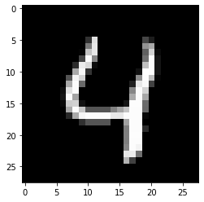
MNIST Data
To get started with CNNs, I worked with the MNIST Data set, using the Keras deep learning library on Python to construct my CNN.
The MNIST data comes in 2 forms: images and labels.
Images are the 28x28x1 images of the handwritten numbers. These are the inputs for our CNN
Labels are the numbers that the images are supposed to represent. These are what we will compare our model’s predictions to.
To prepare the data, I converted the grayscale values of the images into floating point numbers between 0 and 1 and centered the images, and converted the data into a (60000, 28, 28, 1) NumPy array (60,000 images of dimensions 28 x 28 x 1)

Slide 6
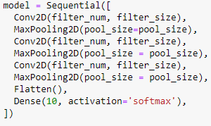
MNIST Architecture
My number of filters: 16
My filter size: 3
My pool size: 2
My number of epochs: 50
My number of convolutional layers: 3
My number of max pooling layers: 3
1 Flatten Layer
1 Fully Connected Layer
Basic Datasets used

Slide 7
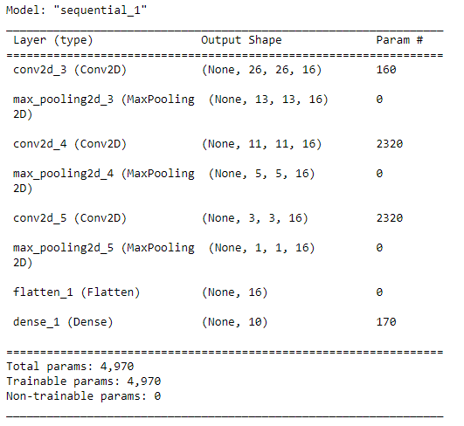
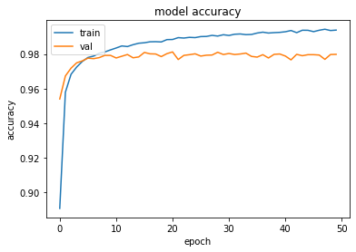
MNIST Results

Slide 8
The TEM Data
The dataset used is of simulated Gallium Arsenide images put through a Transmission Electron Microscope (TEM) at various focal lengths.
To prepare the data, I was asked to create various “windows” whose dimensions were 118 x 84 x 1 out of various TEM images. I was then instructed to create simulated defects to test the model’s defect-detecting capabilities.

Slide 9
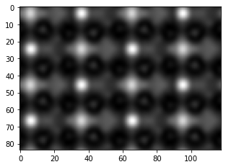
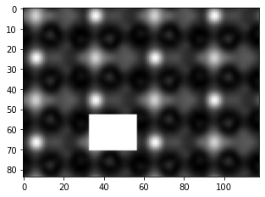
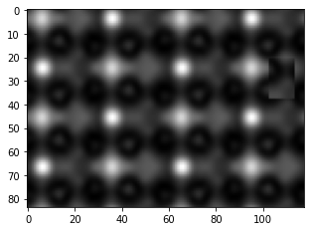
How CutPaste works
At first I made defects in the images by replacing parts of the images with a white square, which were easily detectable by both the human eye and by a machine. Then, I used the CutPaste method of making defects, which copies a portion of the image and pastes it in another area of the image.
With No Defect
With White Square Defect
With CutPaste Defect

Slide 10
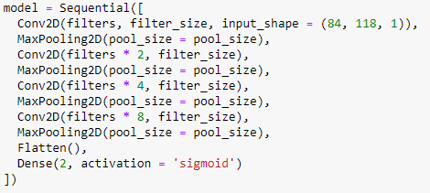
TEM Model Architecture
My number of filters: 32
My filter size: 3
My pool size: 2
My number of epochs: 25
My number of convolutional layers: 4
My number of max pooling layers: 4
1 Flatten Layer
1 Fully-Connected Layer
Data generators used for inputs

Slide 11
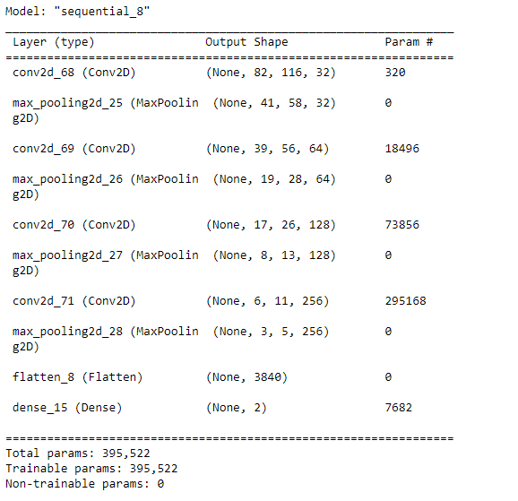
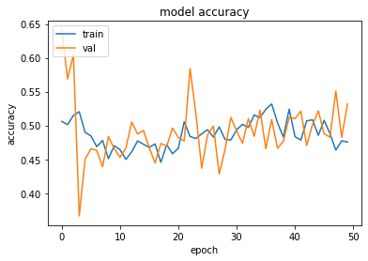
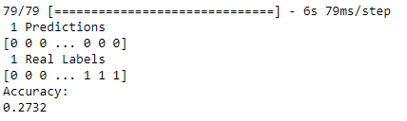
TEM Model Results

Slide 12
Conclusions
A LeNet CNN is not accurate and sophisticated enough to perform tasks like defect detection in largely uniform TEM Images having long training times or being computationally expensive.
More sophisticated neural networks (such as Residual Neural Networks) are recommended for these tasks. My next steps are to create and test residual neural networks in order to increase both performance and accuracy of the neural network.

Slide 13
Acknowledgements
Thank you to Dr. Aihua Wood and Major Phillip Cho for hosting me at AFIT as an intern - I have learned a lot from both of you.
The CNN Diagram was taken from https://towardsdatascience.com/a-comprehensive-guide-to-convolutional-neural-networks-the-eli5-way-3bd2b1164a53

